Slide 1
Chapter 2 Classes: A Deeper Look

Slide 2
Introduction
const objects and const member functions
prevent modifications of objects and enforce the principle of least privilege.
Composition
a form of reuse in which a class can have objects of other classes as members.
Friendship
enables a class designer to specify nonmember functions that can access a class’s non-public members
The this pointer
an implicit argument to each of a class’s non-static member functions.
allows those member functions to access the correct object’s data members and other non-static member functions.

Slide 3
const Objects and const Member Functions
You may use keyword const to specify that an object is not modifiable and that any attempt to modify the object should result in a compilation error.
C++ disallows member function calls for const objects unless the member functions themselves are also declared const.
A member function is specified as const both in its prototype and in its definition.

Slide 4
class Date
{
public:
Date( int y = 2000, int m = 1, int d = 1 ); // constructor
void setDate( int y, int m, int d ); // set year, month and day
void setYear( int y ); // set year
void setMonth( int m ); // set month
void setDay( int d ); // set day
int getYear() const; // return year
int getMonth() const; // return month
int getDay() const; // return day
void print() const; // print Date in the format yyyy/mm/dd
private:
int year{};
int month{};
int day{};
};

Slide 5
Date::Date( int y, int m, int d )
{
setDate( y, m, d );
}
void Date::setYear( int y ) // set year
{
year = ( y >= 1583 ) ? y : 1583;
}
void Date::setMonth( int m ) // set month
{
month = ( m >= 1 && m <= 12 ) ? m : 0;
}
void Date::setDay( int d ) // set day
{
int numDays[ 13 ] = { 0, 31, 28, 31, 30, 31, 30, 31, 31, 30,
31, 30, 31 };
if( year % 400 == 0 || ( year % 4 == 0 && year % 100 != 0 ) )
numDays[ 2 ] = 29;
day = ( d >= 1 && d <= numDays[ month ] ) ? d : 0;
}

Slide 6
int Date::getYear() const // return year
{
return year;
}
int Date::getMonth() const // return month
{
return month;
}
int Date::getDay() const // return day
{
return day;
}
void Date::print() const
{
cout << setfill( '0' ) << setw( 4 ) << year << '/'
<< setw( 2 ) << month << '/'
<< setw( 2 ) << day << endl << endl;
}

Slide 7
int main()
{
tm timeInfo;
time_t rawTime = time( nullptr );
localtime_s( &timeInfo, &rawTime );
Date date1{ timeInfo.tm_year + 1900, timeInfo.tm_mon + 1,
timeInfo.tm_mday };
const Date date2( 2000, 1, 1 );
// object member function
date1.setYear( 1900 ); // const non-const
date1.print(); // const const
date2.setYear( 1900 ); // non-const non-const
date2.print(); // non-const const
}

Slide 8
Member Initializer List
Member initializer list
All data members can be initialized using member initializer syntax, but const data members and data members that are references must be initialized using member initializers.
Member initializers appear between a constructor’s parameter list and the left brace that begins the constructor’s body.
Separated from the parameter list with a colon (:).
Each member initializer consists of the data member name followed by parentheses containing the member’s initial value.

Slide 9
class Circle
{
public:
Circle();
Circle( double r );
void setRadius( double r );
double getRadius();
double getArea();
double getDiameter();
double getCircumference();
private:
double radius;
const double pi;
};

Slide 10
Circle::Circle()
: radius( 0.0 ),
pi( 3.141592653589793238462643383279502884197169399 )
{
}
Circle::Circle( double r )
: radius( r >= 0.0 ? r : 0.0 ),
pi( 3.141592653589793238462643383279502884197169399 )
{
}
void Circle::setRadius( double r )
{
radius = r >= 0.0 ? r : 0.0;
}

Slide 11
double Circle::getRadius()
{
return radius;
}
double Circle::getArea()
{
return pi * radius * radius;
}
double Circle::getDiameter()
{
return radius * 2;
}
double Circle::getCircumference()
{
return 2 * pi * radius;
}

Slide 12
int main()
{
double radius;
cout << "Enter the radius: ";
cin >> radius;
cout << endl;
if( radius < 0.0 )
cout << "The radius cannot be negative" << endl << endl;
else
{
Circle circle( radius );
cout << "Radius: " << circle.getRadius() << endl;
cout << "Area: " << circle.getArea() << endl;
cout << "Diameter: " << circle.getDiameter() << endl;
cout << "Circumference: " << circle.getCircumference()
<< endl << endl;
}
}

Slide 13
Circle::Circle()
{
radius = r >= 0.0 ? r : 0.0;
pi = 3.141592653589793238462643383279502884197169399; // error
}
double Circle::getRadius()
{
return radius;
}
double Circle::getArea()
{
return pi * radius * radius;
}
double Circle::getDiameter()
{
return radius * 2;
}
double Circle::getCircumference()
{
return 2 * pi * radius;
}

Slide 14
class Circle
{
public:
Circle( double r );
private:
double radius;
const double pi;
};
Circle::Circle()
{
radius = r >= 0.0 ? r : 0.0;
pi = 3.14159;
}
int main()
{
Circle circle( radius );
}
int main()
{
double radius;
const double pi;
radius = r >= 0.0 ? r : 0.0;
pi = 3.14159;
}

Slide 15
class Circle
{
public:
Circle( double r );
private:
double radius;
const double pi;
};
Circle::Circle( double r )
: radius( r >= 0.0 ? r : 0.0 ),
pi( 3.14159 )
{
}
int main()
{
Circle circle( radius );
}
int main()
{
double radius = r >= 0.0 ? r : 0.0;
const double pi = 3.14159;
}

Slide 16
class A
{
public:
A( int a, int &c )
: mA( a ),
counter( c )
{
counter++;
}
private:
int mA;
int &counter;
};

Slide 17
class B
{
public:
B( int b, int &c )
: mB( b ),
counter( c )
{
counter++;
}
private:
int mB;
int &counter;
};

Slide 18
int main()
{
int counter = 0;
A a( 1, counter );
cout << "counter: " << counter << endl;
B b( 2, counter );
cout << "counter: " << counter << endl << endl;
}
Output
counter: 1
counter: 2

Slide 19
class A
{
public:
A( int a, int &c )
: mA( a ),
counter( c )
{
counter++;
}
private:
int mA;
int &counter;
};
class B
{
public:
B( int b, int &c )
: mB( b ),
counter( c )
{
counter++;
}
private:
int mB;
int &counter;
};
int main()
{
int counter = 0;
A a( 1, counter );
cout << "counter: " << counter << endl;
B b( 2, counter );
cout << "counter: " << counter << endl;
}
int main()
{
int mA = a;
int &counter = c;
}

Slide 20
class A
{
public:
A( int a, int &c )
{
mA = a;
counter = c;
counter++;
}
private:
int mA;
int &counter;
};
class B
{
public:
B( int b, int &c )
{
mB = b;
counter = c;
counter++;
}
private:
int mB;
int &counter;
};
int main()
{
int counter = 0;
A a( 1, counter );
cout << "counter: " << counter << endl;
B b( 2, counter );
cout << "counter: " << counter << endl;
}
int main()
{
int mA;
int &counter;
mA = a;
counter = c;
}

Slide 21
class A
{
public:
A( int a, int &c )
: mA( a ),
counter( c )
{
counter++;
}
private:
int mA;
int &counter;
};
c
int main()
{
int counter = 0;
A a( 1, counter ); a.A( 1, counter )
cout << "counter: " << counter << endl;
}
0

Slide 22
class A
{
public:
A( int a, int &c )
: mA( a ),
counter( c )
{
counter++;
}
private:
int mA;
int &counter;
};
c
int main()
{
int counter = 0;
A a( 1, counter ); a.A( 1, counter )
cout << "counter: " << counter << endl;
}
1

Slide 23
class A
{
public:
A( int a, int c )
: mA( a ),
counter( c )
{
counter++;
}
private:
int mA;
int &counter;
};
c
int main()
{
int counter = 0;
A a( 1, counter ); a.A( 1, counter )
cout << "counter: " << counter << endl;
}
0

Slide 24
class A
{
public:
A( int a, int c )
: mA( a ),
counter( c )
{
counter++;
}
private:
int mA;
int &counter;
};
0
c
int main()
{
int counter = 0;
A a( 1, counter ); a.A( 1, counter )
cout << "counter: " << counter << endl;
}
0

Slide 25
class A
{
public:
A( int a, int c )
: mA( a ),
counter( c )
{
counter++;
}
private:
int mA;
int &counter;
};
1
c
int main()
{
int counter = 0;
A a( 1, counter ); a.A( 1, counter )
cout << "counter: " << counter << endl;
}
0

Slide 26
Using the this Pointer
How do member functions know which object’s data members to manipulate? Every object has access to its own address through a pointer called this (a C++ keyword).
The this pointer is passed (by the compiler) as an implicit argument to each of the object’s non-static member functions.

Slide 27
int main()
{
A a( 12 );
a.print();
}
void A::print() const
{
cout << " mA = " << mA;
cout << "\n this->mA = " << this->mA;
cout << "\n(*this).mA = " << ( *this ).mA << endl;
}
class A
{
public:
A( int value = 0 );
void print() const;
private:
int mA;
};
a.mA | 12 | 0037FDCC
(*this).mA = 12
(*this->mA = 12
(*this).mA = 12
Output

Slide 28
int main()
{
A a( 12 );
a.print();
}
void A::print( A * const this ) const
{
cout << " mA = " << mA;
cout << "\n this->mA = " << this->mA;
cout << "\n(*this).mA = " << ( *this ).mA << endl;
}
class A
{
public:
A( int value = 0 );
void print( A * const this ) const;
private:
int mA;
};
a.mA | 12 | 0037FDCC
(*this).mA = 12
(*this->mA = 12
(*this).mA = 12
Output

Slide 29
int main()
{
A a( 12 );
a.print();
}
void A::print( A * const this ) const
{
cout << " mA = " << mA;
cout << "\n this->mA = " << this->mA;
cout << "\n(*this).mA = " << ( *this ).mA << endl;
}
class A
{
public:
A( int value = 0 );
void print( A * const this ) const;
private:
int mA;
};
a.mA | 12 | 0037FDCC
this | 0037FDCC | 0000BBCC
(*this).mA = 12
(*this->mA = 12
(*this).mA = 12
Output

Slide 30
class Date
{
public:
Date( int y = 2000, int m = 1, int d = 1 );
Date& setDate( int y, int m, int d );
Date& setYear( int y ); // set year
Date& setMonth( int m ); // set month
Date& setDay( int d ); // set day
int getYear() const; // return year
int getMonth() const; // return month
int getDay() const; // return day
void print() const; // print Date in the format yyyy/mm/dd
private:
int year{};
int month{};
int day{};
};

Slide 31
Date::Date( int y, int m, int d )
{
setDate( y, m, d );
}
Date& Date::setDate( int y, int m, int d )
{
setYear( y ); // set year
setMonth( m ); // set month
setDay( d ); // set day
return *this; // enables cascading
}
Date& Date::setYear( int y ) // set year
{
year = ( y >= 1583 ) ? y : 1583;
return *this; // enables cascading
}
Date& Date::setMonth( int m ) // set month
{
month = ( m >= 1 && m <= 12 ) ? m : 0;
return *this; // enables cascading
}

Slide 32
Date& Date::setDay( int d ) // set day
{
int numDays[ 13 ] = { 0, 31, 28, 31, 30, 31, 30, 31, 31, 30,
31, 30, 31 };
if( year % 400 == 0 || ( year % 4 == 0 && year % 100 != 0 ) )
numDays[ 2 ] = 29;
day = ( d >= 1 && d <= numDays[ month ] ) ? d : 0;
return *this; // enables cascading
}
int Date::getYear() const // return year
{
return year;
}
int Date::getMonth() const // return month
{
return month;
}

Slide 33
int Date::getDay() const // return day
{
return day;
}
void Date::print() const
{
cout << setfill( '0' ) << setw( 4 ) << year << '/'
<< setw( 2 ) << month << '/'
<< setw( 2 ) << day << endl << endl;
}
int main()
{
Date d;
d.setYear( 2023 ).setMonth( 3 ).setDay( 1 );
d.print();
d.setDate( 2000, 1, 1 ).print();
}

Slide 34
Date& Date::setYear( int y )
{
year = ( y >= 1583 ) ? y : 1583;
return *this;
}
Date& Date::setMonth( int m )
{
month = ( m >= 1 && m <= 12 ) ? m : 0;
return *this;
}
Date& Date::setDay( int d )
{
int numDays[ 13 ] = { 0, 31, 28, 31, 30, 31, 30, 31, 31, 30, 31, 30, 31 };
if( year % 400 == 0 || ( year % 4 == 0 && year % 100 != 0 ) )
numDays[ 2 ] = 29;
day = ( d >= 1 && d <= numDays[ month ] ) ? d : 0;
return *this;
}
d
2000 | 1 | 1
int main()
{
Date d;
d.setYear( 2023 ).setMonth( 3 ).setDay( 2 );
}

Slide 35
Date& Date::setYear( int y, Date * const this )
{
year = ( y >= 1583 ) ? y : 1583;
return *this;
}
Date& Date::setMonth( int m, Date * const this )
{
month = ( m >= 1 && m <= 12 ) ? m : 0;
return *this;
}
Date& Date::setDay( int d, Date * const this )
{
int numDays[ 13 ] = { 0, 31, 28, 31, 30, 31, 30, 31, 31, 30, 31, 30, 31 };
if( year % 400 == 0 || ( year % 4 == 0 && year % 100 != 0 ) )
numDays[ 2 ] = 29;
day = ( d >= 1 && d <= numDays[ month ] ) ? d : 0;
return *this;
}
d
2000 | 1 | 1
int main()
{
Date d;
d.setYear( 2023, &d ).setMonth( 3, &an1 ).setDay( 2, &an2 );
}

Slide 36
Date& Date::setYear( int y, Date * const this )
{
year = ( y >= 1583 ) ? y : 1583;
return *this;
}
Date& Date::setMonth( int m, Date * const this )
{
month = ( m >= 1 && m <= 12 ) ? m : 0;
return *this;
}
Date& Date::setDay( int d, Date * const this )
{
int numDays[ 13 ] = { 0, 31, 28, 31, 30, 31, 30, 31, 31, 30, 31, 30, 31 };
if( year % 400 == 0 || ( year % 4 == 0 && year % 100 != 0 ) )
numDays[ 2 ] = 29;
day = ( d >= 1 && d <= numDays[ month ] ) ? d : 0;
return *this;
}
d
2000 | 1 | 1
int main()
{
Date d;
d.setYear( 2023, &d ).setMonth( 3, &an1 ).setDay( 2, &an2 );
}

Slide 37
Date& Date::setYear( int y, Date * const this )
{
year = ( y >= 1583 ) ? y : 1583;
return *this;
}
Date& Date::setMonth( int m, Date * const this )
{
month = ( m >= 1 && m <= 12 ) ? m : 0;
return *this;
}
Date& Date::setDay( int d, Date * const this )
{
int numDays[ 13 ] = { 0, 31, 28, 31, 30, 31, 30, 31, 31, 30, 31, 30, 31 };
if( year % 400 == 0 || ( year % 4 == 0 && year % 100 != 0 ) )
numDays[ 2 ] = 29;
day = ( d >= 1 && d <= numDays[ month ] ) ? d : 0;
return *this;
}
d
2023 | 1 | 1
int main()
{
Date d;
d.setYear( 2023, &d ).setMonth( 3, &an1 ).setDay( 2, &an2 );
}

Slide 38
Date& Date::setYear( int y, Date * const this )
{
year = ( y >= 1583 ) ? y : 1583;
return *this;
}
Date& Date::setMonth( int m, Date * const this )
{
month = ( m >= 1 && m <= 12 ) ? m : 0;
return *this;
}
Date& Date::setDay( int d, Date * const this )
{
int numDays[ 13 ] = { 0, 31, 28, 31, 30, 31, 30, 31, 31, 30, 31, 30, 31 };
if( year % 400 == 0 || ( year % 4 == 0 && year % 100 != 0 ) )
numDays[ 2 ] = 29;
day = ( d >= 1 && d <= numDays[ month ] ) ? d : 0;
return *this;
}
d
2023 | 1 | 1
int main()
{
Date d;
d.setYear( 2023, &d ).setMonth( 3, &an1 ).setDay( 2, &an2 );
}
an1

Slide 39
Date& Date::setYear( int y, Date * const this )
{
year = ( y >= 1583 ) ? y : 1583;
return *this;
}
Date& Date::setMonth( int m, Date * const this )
{
month = ( m >= 1 && m <= 12 ) ? m : 0;
return *this;
}
Date& Date::setDay( int d, Date * const this )
{
int numDays[ 13 ] = { 0, 31, 28, 31, 30, 31, 30, 31, 31, 30, 31, 30, 31 };
if( year % 400 == 0 || ( year % 4 == 0 && year % 100 != 0 ) )
numDays[ 2 ] = 29;
day = ( d >= 1 && d <= numDays[ month ] ) ? d : 0;
return *this;
}
d
2023 | 1 | 1
int main()
{
Date d;
d.setYear( 2023, &d ).setMonth( 3, &an1 ).setDay( 2, &an2 );
}
an1

Slide 40
Date& Date::setYear( int y, Date * const this )
{
year = ( y >= 1583 ) ? y : 1583;
return *this;
}
Date& Date::setMonth( int m, Date * const this )
{
month = ( m >= 1 && m <= 12 ) ? m : 0;
return *this;
}
Date& Date::setDay( int d, Date * const this )
{
int numDays[ 13 ] = { 0, 31, 28, 31, 30, 31, 30, 31, 31, 30, 31, 30, 31 };
if( year % 400 == 0 || ( year % 4 == 0 && year % 100 != 0 ) )
numDays[ 2 ] = 29;
day = ( d >= 1 && d <= numDays[ month ] ) ? d : 0;
return *this;
}
d
2023 | 1 | 1
int main()
{
Date d;
d.setYear( 2023, &d ).setMonth( 3, &an1 ).setDay( 2, &an2 );
}
an1

Slide 41
Date& Date::setYear( int y, Date * const this )
{
year = ( y >= 1583 ) ? y : 1583;
return *this;
}
Date& Date::setMonth( int m, Date * const this )
{
month = ( m >= 1 && m <= 12 ) ? m : 0;
return *this;
}
Date& Date::setDay( int d, Date * const this )
{
int numDays[ 13 ] = { 0, 31, 28, 31, 30, 31, 30, 31, 31, 30, 31, 30, 31 };
if( year % 400 == 0 || ( year % 4 == 0 && year % 100 != 0 ) )
numDays[ 2 ] = 29;
day = ( d >= 1 && d <= numDays[ month ] ) ? d : 0;
return *this;
}
d
2023 | 3 | 1
int main()
{
Date d;
d.setYear( 2023, &d ).setMonth( 3, &an1 ).setDay( 2, &an2 );
}
an1

Slide 42
Date& Date::setYear( int y, Date * const this )
{
year = ( y >= 1583 ) ? y : 1583;
return *this;
}
Date& Date::setMonth( int m, Date * const this )
{
month = ( m >= 1 && m <= 12 ) ? m : 0;
return *this;
}
Date& Date::setDay( int d, Date * const this )
{
int numDays[ 13 ] = { 0, 31, 28, 31, 30, 31, 30, 31, 31, 30, 31, 30, 31 };
if( year % 400 == 0 || ( year % 4 == 0 && year % 100 != 0 ) )
numDays[ 2 ] = 29;
day = ( d >= 1 && d <= numDays[ month ] ) ? d : 0;
return *this;
}
d
2023 | 3 | 1
int main()
{
Date d;
d.setYear( 2023, &d ).setMonth( 3, &an1 ).setDay( 2, &an2 );
}
an1
an2

Slide 43
Date& Date::setYear( int y, Date * const this )
{
year = ( y >= 1583 ) ? y : 1583;
return *this;
}
Date& Date::setMonth( int m, Date * const this )
{
month = ( m >= 1 && m <= 12 ) ? m : 0;
return *this;
}
Date& Date::setDay( int d, Date * const this )
{
int numDays[ 13 ] = { 0, 31, 28, 31, 30, 31, 30, 31, 31, 30, 31, 30, 31 };
if( year % 400 == 0 || ( year % 4 == 0 && year % 100 != 0 ) )
numDays[ 2 ] = 29;
day = ( d >= 1 && d <= numDays[ month ] ) ? d : 0;
return *this;
}
d
2023 | 3 | 1
int main()
{
Date d;
d.setYear( 2023, &d ).setMonth( 3, &an1 ).setDay( 2, &an2 );
}
an1
an2

Slide 44
Date& Date::setYear( int y, Date * const this )
{
year = ( y >= 1583 ) ? y : 1583;
return *this;
}
Date& Date::setMonth( int m, Date * const this )
{
month = ( m >= 1 && m <= 12 ) ? m : 0;
return *this;
}
Date& Date::setDay( int d, Date * const this )
{
int numDays[ 13 ] = { 0, 31, 28, 31, 30, 31, 30, 31, 31, 30, 31, 30, 31 };
if( year % 400 == 0 || ( year % 4 == 0 && year % 100 != 0 ) )
numDays[ 2 ] = 29;
day = ( d >= 1 && d <= numDays[ month ] ) ? d : 0;
return *this;
}
d
2023 | 3 | 1
int main()
{
Date d;
d.setYear( 2023, &d ).setMonth( 3, &an1 ).setDay( 2, &an2 );
}
an1
an2

Slide 45
Date& Date::setYear( int y, Date * const this )
{
year = ( y >= 1583 ) ? y : 1583;
return *this;
}
Date& Date::setMonth( int m, Date * const this )
{
month = ( m >= 1 && m <= 12 ) ? m : 0;
return *this;
}
Date& Date::setDay( int d, Date * const this )
{
int numDays[ 13 ] = { 0, 31, 28, 31, 30, 31, 30, 31, 31, 30, 31, 30, 31 };
if( year % 400 == 0 || ( year % 4 == 0 && year % 100 != 0 ) )
numDays[ 2 ] = 29;
day = ( d >= 1 && d <= numDays[ month ] ) ? d : 0;
return *this;
}
d
2023 | 3 | 2
int main()
{
Date d;
d.setYear( 2023, &d ).setMonth( 3, &an1 ).setDay( 2, &an2 );
}
an1
an2

Slide 46
Date& Date::setYear( int y, Date * const this )
{
year = ( y >= 1583 ) ? y : 1583;
return *this;
}
Date& Date::setMonth( int m, Date * const this )
{
month = ( m >= 1 && m <= 12 ) ? m : 0;
return *this;
}
Date& Date::setDay( int d, Date * const this )
{
int numDays[ 13 ] = { 0, 31, 28, 31, 30, 31, 30, 31, 31, 30, 31, 30, 31 };
if( year % 400 == 0 || ( year % 4 == 0 && year % 100 != 0 ) )
numDays[ 2 ] = 29;
day = ( d >= 1 && d <= numDays[ month ] ) ? d : 0;
return *this;
}
d
2023 | 3 | 2
int main()
{
Date d;
d.setYear( 2023, &d ).setMonth( 3, &an1 ).setDay( 2, &an2 );
}
an1
an2
an3

Slide 47
Date& Date::setYear( int y, Date * const this )
{
year = ( y >= 1583 ) ? y : 1583;
return *this;
}
Date& Date::setMonth( int m, Date * const this )
{
month = ( m >= 1 && m <= 12 ) ? m : 0;
return *this;
}
Date& Date::setDay( int d, Date * const this )
{
int numDays[ 13 ] = { 0, 31, 28, 31, 30, 31, 30, 31, 31, 30, 31, 30, 31 };
if( year % 400 == 0 || ( year % 4 == 0 && year % 100 != 0 ) )
numDays[ 2 ] = 29;
day = ( d >= 1 && d <= numDays[ month ] ) ? d : 0;
return *this;
}
d
2023 | 3 | 2
int main()
{
Date d;
d.setYear( 2023, &d ).setMonth( 3, &an1 ).setDay( 2, &an2 );
}
an1
an2
an3

Slide 49
int main()
{
Date d;
d.setYear( 2023 ).setMonth( 3 ).setDay( 1 );
}
d
2000 | 1 | 1
Date Date::setYear( int y )
{
year = ( y >= 1583 ) ? y : 1583;
return *this;
}
Date Date::setMonth( int m )
{
month = ( m >= 1 && m <= 12 ) ? m : 0;
return *this;
}
Date Date::setDay( int d )
{
int numDays[ 13 ] = { 0, 31, 28, 31, 30, 31, 30, 31, 31, 30, 31, 30, 31 };
if( year % 400 == 0 || ( year % 4 == 0 && year % 100 != 0 ) )
numDays[ 2 ] = 29;
day = ( d >= 1 && d <= numDays[ month ] ) ? d : 0;
return *this;
}

Slide 50
int main()
{
Date d;
d.setYear(2023, &d ).setMonth( 3, &an1 ).setDay( 2, &an2 );
}
d
2000 | 1 | 1
an1
an2
an3
Date Date::setYear( int y, Date * const this )
{
year = ( y >= 1583 ) ? y : 1583;
return *this;
}
Date Date::setMonth( int m, Date * const this )
{
month = ( m >= 1 && m <= 12 ) ? m : 0;
return *this;
}
Date Date::setDay( int d, Date * const this )
{
int numDays[ 13 ] = { 0, 31, 28, 31, 30, 31, 30, 31, 31, 30, 31, 30, 31 };
if( year % 400 == 0 || ( year % 4 == 0 && year % 100 != 0 ) )
numDays[ 2 ] = 29;
day = ( d >= 1 && d <= numDays[ month ] ) ? d : 0;
return *this;
}

Slide 51
int main()
{
Date d;
d.setYear(2023, &d ).setMonth( 3, &an1 ).setDay( 2, &an2 );
}
d
2000 | 1 | 1
an1
an2
an3
Date Date::setYear( int y, Date * const this )
{
year = ( y >= 1583 ) ? y : 1583;
return *this;
}
Date Date::setMonth( int m, Date * const this )
{
month = ( m >= 1 && m <= 12 ) ? m : 0;
return *this;
}
Date Date::setDay( int d, Date * const this )
{
int numDays[ 13 ] = { 0, 31, 28, 31, 30, 31, 30, 31, 31, 30, 31, 30, 31 };
if( year % 400 == 0 || ( year % 4 == 0 && year % 100 != 0 ) )
numDays[ 2 ] = 29;
day = ( d >= 1 && d <= numDays[ month ] ) ? d : 0;
return *this;
}

Slide 52
int main()
{
Date d;
d.setYear(2023, &d ).setMonth( 3, &an1 ).setDay( 2, &an2 );
}
d
2023 | 1 | 1
an1
an2
an3
Date Date::setYear( int y, Date * const this )
{
year = ( y >= 1583 ) ? y : 1583;
return *this;
}
Date Date::setMonth( int m, Date * const this )
{
month = ( m >= 1 && m <= 12 ) ? m : 0;
return *this;
}
Date Date::setDay( int d, Date * const this )
{
int numDays[ 13 ] = { 0, 31, 28, 31, 30, 31, 30, 31, 31, 30, 31, 30, 31 };
if( year % 400 == 0 || ( year % 4 == 0 && year % 100 != 0 ) )
numDays[ 2 ] = 29;
day = ( d >= 1 && d <= numDays[ month ] ) ? d : 0;
return *this;
}

Slide 53
int main()
{
Date d;
d.setYear(2023, &d ).setMonth( 3, &an1 ).setDay( 2, &an2 );
}
d
2023 | 1 | 1
2023 | 1 | 1
an1
an2
an3
Date Date::setYear( int y, Date * const this )
{
year = ( y >= 1583 ) ? y : 1583;
return *this;
}
Date Date::setMonth( int m, Date * const this )
{
month = ( m >= 1 && m <= 12 ) ? m : 0;
return *this;
}
Date Date::setDay( int d, Date * const this )
{
int numDays[ 13 ] = { 0, 31, 28, 31, 30, 31, 30, 31, 31, 30, 31, 30, 31 };
if( year % 400 == 0 || ( year % 4 == 0 && year % 100 != 0 ) )
numDays[ 2 ] = 29;
day = ( d >= 1 && d <= numDays[ month ] ) ? d : 0;
return *this;
}

Slide 54
int main()
{
Date d;
d.setYear(2023, &d ).setMonth( 3, &an1 ).setDay( 2, &an2 );
}
d
2023 | 1 | 1
2023 | 1 | 1
an1
an2
an3
Date Date::setYear( int y, Date * const this )
{
year = ( y >= 1583 ) ? y : 1583;
return *this;
}
Date Date::setMonth( int m, Date * const this )
{
month = ( m >= 1 && m <= 12 ) ? m : 0;
return *this;
}
Date Date::setDay( int d, Date * const this )
{
int numDays[ 13 ] = { 0, 31, 28, 31, 30, 31, 30, 31, 31, 30, 31, 30, 31 };
if( year % 400 == 0 || ( year % 4 == 0 && year % 100 != 0 ) )
numDays[ 2 ] = 29;
day = ( d >= 1 && d <= numDays[ month ] ) ? d : 0;
return *this;
}

Slide 55
int main()
{
Date d;
d.setYear(2023, &d ).setMonth( 3, &an1 ).setDay( 2, &an2 );
}
d
2023 | 1 | 1
2023 | 3 | 1
an1
an2
an3
Date Date::setYear( int y, Date * const this )
{
year = ( y >= 1583 ) ? y : 1583;
return *this;
}
Date Date::setMonth( int m, Date * const this )
{
month = ( m >= 1 && m <= 12 ) ? m : 0;
return *this;
}
Date Date::setDay( int d, Date * const this )
{
int numDays[ 13 ] = { 0, 31, 28, 31, 30, 31, 30, 31, 31, 30, 31, 30, 31 };
if( year % 400 == 0 || ( year % 4 == 0 && year % 100 != 0 ) )
numDays[ 2 ] = 29;
day = ( d >= 1 && d <= numDays[ month ] ) ? d : 0;
return *this;
}

Slide 56
int main()
{
Date d;
d.setYear(2023, &d ).setMonth( 3, &an1 ).setDay( 2, &an2 );
}
d
2023 | 1 | 1
2023 | 3 | 1
an1
2023 | 3 | 1
an2
an3
Date Date::setYear( int y, Date * const this )
{
year = ( y >= 1583 ) ? y : 1583;
return *this;
}
Date Date::setMonth( int m, Date * const this )
{
month = ( m >= 1 && m <= 12 ) ? m : 0;
return *this;
}
Date Date::setDay( int d, Date * const this )
{
int numDays[ 13 ] = { 0, 31, 28, 31, 30, 31, 30, 31, 31, 30, 31, 30, 31 };
if( year % 400 == 0 || ( year % 4 == 0 && year % 100 != 0 ) )
numDays[ 2 ] = 29;
day = ( d >= 1 && d <= numDays[ month ] ) ? d : 0;
return *this;
}

Slide 57
int main()
{
Date d;
d.setYear(2023, &d ).setMonth( 3, &an1 ).setDay( 2, &an2 );
}
d
2023 | 1 | 1
2023 | 3 | 1
an1
2023 | 3 | 1
an2
an3
Date Date::setYear( int y, Date * const this )
{
year = ( y >= 1583 ) ? y : 1583;
return *this;
}
Date Date::setMonth( int m, Date * const this )
{
month = ( m >= 1 && m <= 12 ) ? m : 0;
return *this;
}
Date Date::setDay( int d, Date * const this )
{
int numDays[ 13 ] = { 0, 31, 28, 31, 30, 31, 30, 31, 31, 30, 31, 30, 31 };
if( year % 400 == 0 || ( year % 4 == 0 && year % 100 != 0 ) )
numDays[ 2 ] = 29;
day = ( d >= 1 && d <= numDays[ month ] ) ? d : 0;
return *this;
}

Slide 58
int main()
{
Date d;
d.setYear(2023, &d ).setMonth( 3, &an1 ).setDay( 2, &an2 );
}
d
2023 | 1 | 1
2023 | 3 | 1
an1
2023 | 3 | 2
an2
an3
Date Date::setYear( int y, Date * const this )
{
year = ( y >= 1583 ) ? y : 1583;
return *this;
}
Date Date::setMonth( int m, Date * const this )
{
month = ( m >= 1 && m <= 12 ) ? m : 0;
return *this;
}
Date Date::setDay( int d, Date * const this )
{
int numDays[ 13 ] = { 0, 31, 28, 31, 30, 31, 30, 31, 31, 30, 31, 30, 31 };
if( year % 400 == 0 || ( year % 4 == 0 && year % 100 != 0 ) )
numDays[ 2 ] = 29;
day = ( d >= 1 && d <= numDays[ month ] ) ? d : 0;
return *this;
}

Slide 59
int main()
{
Date d;
d.setYear(2023, &d ).setMonth( 3, &an1 ).setDay( 2, &an2 );
}
d
2023 | 1 | 1
2023 | 3 | 1
an1
2023 | 3 | 2
an2
2023 | 3 | 2
an3
Date Date::setYear( int y, Date * const this )
{
year = ( y >= 1583 ) ? y : 1583;
return *this;
}
Date Date::setMonth( int m, Date * const this )
{
month = ( m >= 1 && m <= 12 ) ? m : 0;
return *this;
}
Date Date::setDay( int d, Date * const this )
{
int numDays[ 13 ] = { 0, 31, 28, 31, 30, 31, 30, 31, 31, 30, 31, 30, 31 };
if( year % 400 == 0 || ( year % 4 == 0 && year % 100 != 0 ) )
numDays[ 2 ] = 29;
day = ( d >= 1 && d <= numDays[ month ] ) ? d : 0;
return *this;
}

Slide 60
Composition: Objects as Members of Classes
Composition
Sometimes referred to as a has-a relationship
A class can have objects of other classes as members
An object’s constructor can pass arguments to member-object constructors via member initializers.
The compiler provides each class with a default copy constructor that copies each data member of the constructor’s argument object into the corresponding member of the object being initialized.

Slide 61
class Car
{
public:
Car( const string m, const Engine &e );
void display();
private:
string model;
Engine engine;
};
class Engine
{
public:
Engine( string mN = "" );
Engine( const Engine &engine );
void setModelNumber( string mN );
string getModelNumber();
private:
string modelNumber;
};

Slide 62
class Car
{
public:
Car( const string m, const Engine &e );
void display();
private:
string model;
Engine engine;
};
int main()
{
Engine benzM264Engine( "M264" );
Car benzC200( "Benz C200", benzM264Engine );
benzC200.display();
}
benzC200
model
Benz C200
9
15
bx.buf
mySize
myRes
engine
M264
4
15
bx.buf
mySize
myRes
modelNumber

Slide 63
Engine::Engine( const Engine &engine )
: modelNumber( engine.modelNumber )
{
}
Car::Car( const string m, const Engine &e )
: model( m ),
engine( e ) engine.Engine( e )
{
}
int main()
{
Engine benzM264Engine( "M264" );
benzM264Engine.Engine( "M264" )
Car benzC200( "Benz C200", benzM264Engine );
benzC200.Car( "Benz C200", benzM264Engine )
benzC200.display();
}
engine
e
benzM264Engine.modelNumber
M264 | 4 | 15
M264 | 4 | 15
benzC200.model
benzC200.engine.modelNumber

Slide 64
Engine::Engine( const Engine &engine )
: modelNumber( engine.modelNumber )
{
}
Car::Car( const string m,
const Engine &e )
: model( m ),
engine( e ) engine.Engine( e )
{
}
int main()
{
Engine benzM264Engine( "M264" );
benzM264Engine.Engine( "M264" )
Car benzC200( "Benz C200",
benzM264Engine );
benzC200.Car( "Benz C200",
benzM264Engine )
}
class Car
{
private:
string model;
Engine engine;
};
int main()
{
Engine benzM264Engine( "M264" );
test ( benzM264Engine );
}
void test ( const Engine &e )
{
Engine engine( e );
engine.Engine( e )
}

Slide 65
Engine::Engine( string mN )
: modelNumber( mN )
{
}
Car::Car( const string m,
const Engine &e )
{
model = m;
engine = e;
}
int main()
{
Engine benzM264Engine( "M264" );
benzM264Engine.Engine( "M264" )
Car benzC200( "Benz C200",
benzM264Engine );
benzC200.Car( "Benz C200",
benzM264Engine )
}
class Car
{
private:
string model;
Engine engine;
};
int main()
{
Engine benzM264Engine( "M264" );
test ( benzM264Engine );
}
void test ( const Engine &e )
{
Engine engine; engine.Engine()
engine = e;
}

Slide 66
Composition: Objects as Members of Classes
If a member object is not initialized through a member initializer, the member object’s default constructor will be called implicitly.
In other words, if a class doesn't have a default constructor, or you have a const member variable, you must use an member initializer.

Slide 67
friend Functions and friend Classes
A friend function of a class is defined outside that class’s scope, yet has the right to access the non-public (and public) members of the class.
Standalone functions, entire classes or member functions of other classes may be declared to be friends of another class.

Slide 68
class A
{
public:
friend bool isEqual( const A &a1, const A &a2 );
A( int m )
: mA{ m }
{
}
private:
int mA{};
};
bool isEqual( const A &a1, const A &a2 )
{
return ( a1.mA == a2.mA );
}
int main()
{
A a1{ 5 };
A a2{ 6 };
cout << boolalpha << isEqual( a1, a2 ) << endl << endl;
}

Slide 70
bool HugeInteger::less( HugeInteger y )
{
⋅⋅⋅⋅⋅⋅⋅⋅⋅⋅⋅⋅⋅⋅⋅⋅⋅⋅⋅⋅⋅⋅⋅⋅⋅⋅⋅⋅⋅⋅⋅⋅⋅⋅⋅⋅⋅⋅⋅⋅⋅⋅⋅⋅⋅⋅⋅⋅
}
bool HugeInteger::greater( HugeInteger x )
{
return ( x.less( *this ) ); // n2.less( n1 )
}
int main()
{
HugeInteger n1( 30 );
HugeInteger n2( 35 );
if ( n1.greater( n2 ) )
{
n1.output();
cout << " is greater than ";
n2.output();
}
}
30
35

Slide 71
bool HugeInteger::less( HugeInteger y, HugeInteger * const this )
{
⋅⋅⋅⋅⋅⋅⋅⋅⋅⋅⋅⋅⋅⋅⋅⋅⋅⋅⋅⋅⋅⋅⋅⋅⋅⋅⋅⋅⋅⋅⋅⋅⋅⋅⋅⋅⋅⋅⋅⋅⋅⋅⋅⋅⋅⋅⋅⋅
}
bool HugeInteger::greater( HugeInteger x, HugeInteger * const this )
{
return ( x.less( *this, &x ) ); // n2.less( n1 )
}
int main()
{
HugeInteger n1( 30 );
HugeInteger n2( 35 );
if ( n1.greater( n2, &n1 ) )
{
n1.output( &n1 );
cout << " is greater than ";
n2.output( &n2 );
}
}
30
35

Slide 72
bool HugeInteger::less( HugeInteger y, HugeInteger * const this )
{
⋅⋅⋅⋅⋅⋅⋅⋅⋅⋅⋅⋅⋅⋅⋅⋅⋅⋅⋅⋅⋅⋅⋅⋅⋅⋅⋅⋅⋅⋅⋅⋅⋅⋅⋅⋅⋅⋅⋅⋅⋅⋅⋅⋅⋅⋅⋅⋅
}
bool HugeInteger::greater( HugeInteger x, HugeInteger * const this )
{
return ( x.less( *this, &x ) ); // n2.less( n1 )
}
35
int main()
{
HugeInteger n1( 30 );
HugeInteger n2( 35 );
if ( n1.greater( n2, &n1 ) )
{
n1.output( &n1 );
cout << " is greater than ";
n2.output( &n2 );
}
}
30
35

Slide 73
30
bool HugeInteger::less( HugeInteger y, HugeInteger * const this )
{
⋅⋅⋅⋅⋅⋅⋅⋅⋅⋅⋅⋅⋅⋅⋅⋅⋅⋅⋅⋅⋅⋅⋅⋅⋅⋅⋅⋅⋅⋅⋅⋅⋅⋅⋅⋅⋅⋅⋅⋅⋅⋅⋅⋅⋅⋅⋅⋅
}
bool HugeInteger::greater( HugeInteger x, HugeInteger * const this )
{
return ( x.less( *this, &x ) ); // n2.less( n1 )
}
35
int main()
{
HugeInteger n1( 30 );
HugeInteger n2( 35 );
if ( n1.greater( n2, &n1 ) )
{
n1.output( &n1 );
cout << " is greater than ";
n2.output( &n2 );
}
}
30
35

Slide 75
10.6 static Class Members
In certain cases, only one copy of a variable should be shared by all objects of a class.
A static data member is used for these and other reasons.
Such a variable represents “class-wide” information.

Slide 76
10.6 static Class Members (cont.)
Although they may seem like global variables, a class’s static data members have class scope.
static members can be declared public, private or protected.
A fundamental-type static data member is initialized by default to 0. If you want a different initial value, a static data member can be initialized once.
A static const data member of int or enum type can be initialized in its declaration in the class definition.
All other static data members must be defined at global namespace scope (i.e., outside the body of the class definition) and can be initialized only in those definitions.
If a static data member is an object of a class that provides a default constructor, the static data member need not be initialized because its default constructor will be called.

Slide 77
10.6 static Class Members (cont.)
A class’s private and protected static members are normally accessed through the class’s public member functions or friends.
A class’s static members exist even when no objects of that class exist.
To access a public static class member when no objects of the class exist, prefix the class name and the binary scope resolution operator (::) to the name of the data member.
To access a private or protected static class member when no objects of the class exist, provide a public static member function and call the function by prefixing its name with the class name and binary scope resolution operator.
A static member function is a service of the class, not of a specific object of the class.

Slide 78
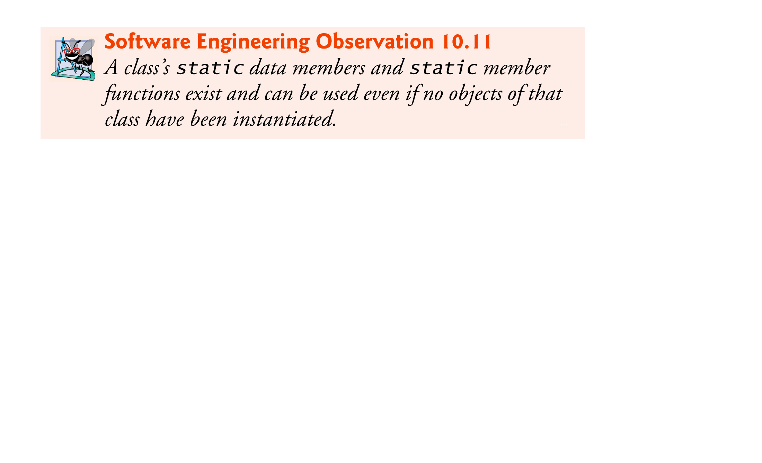

Slide 79
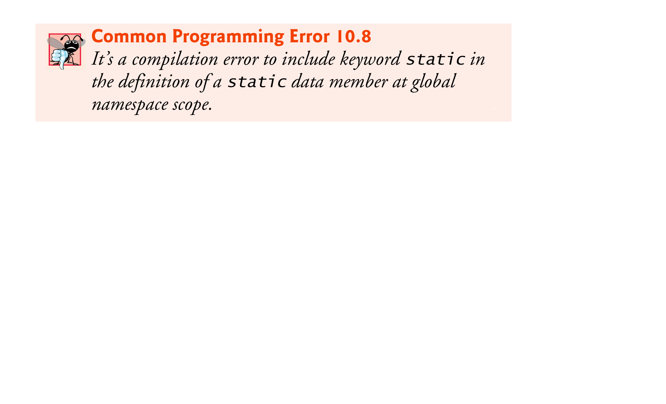

Slide 80
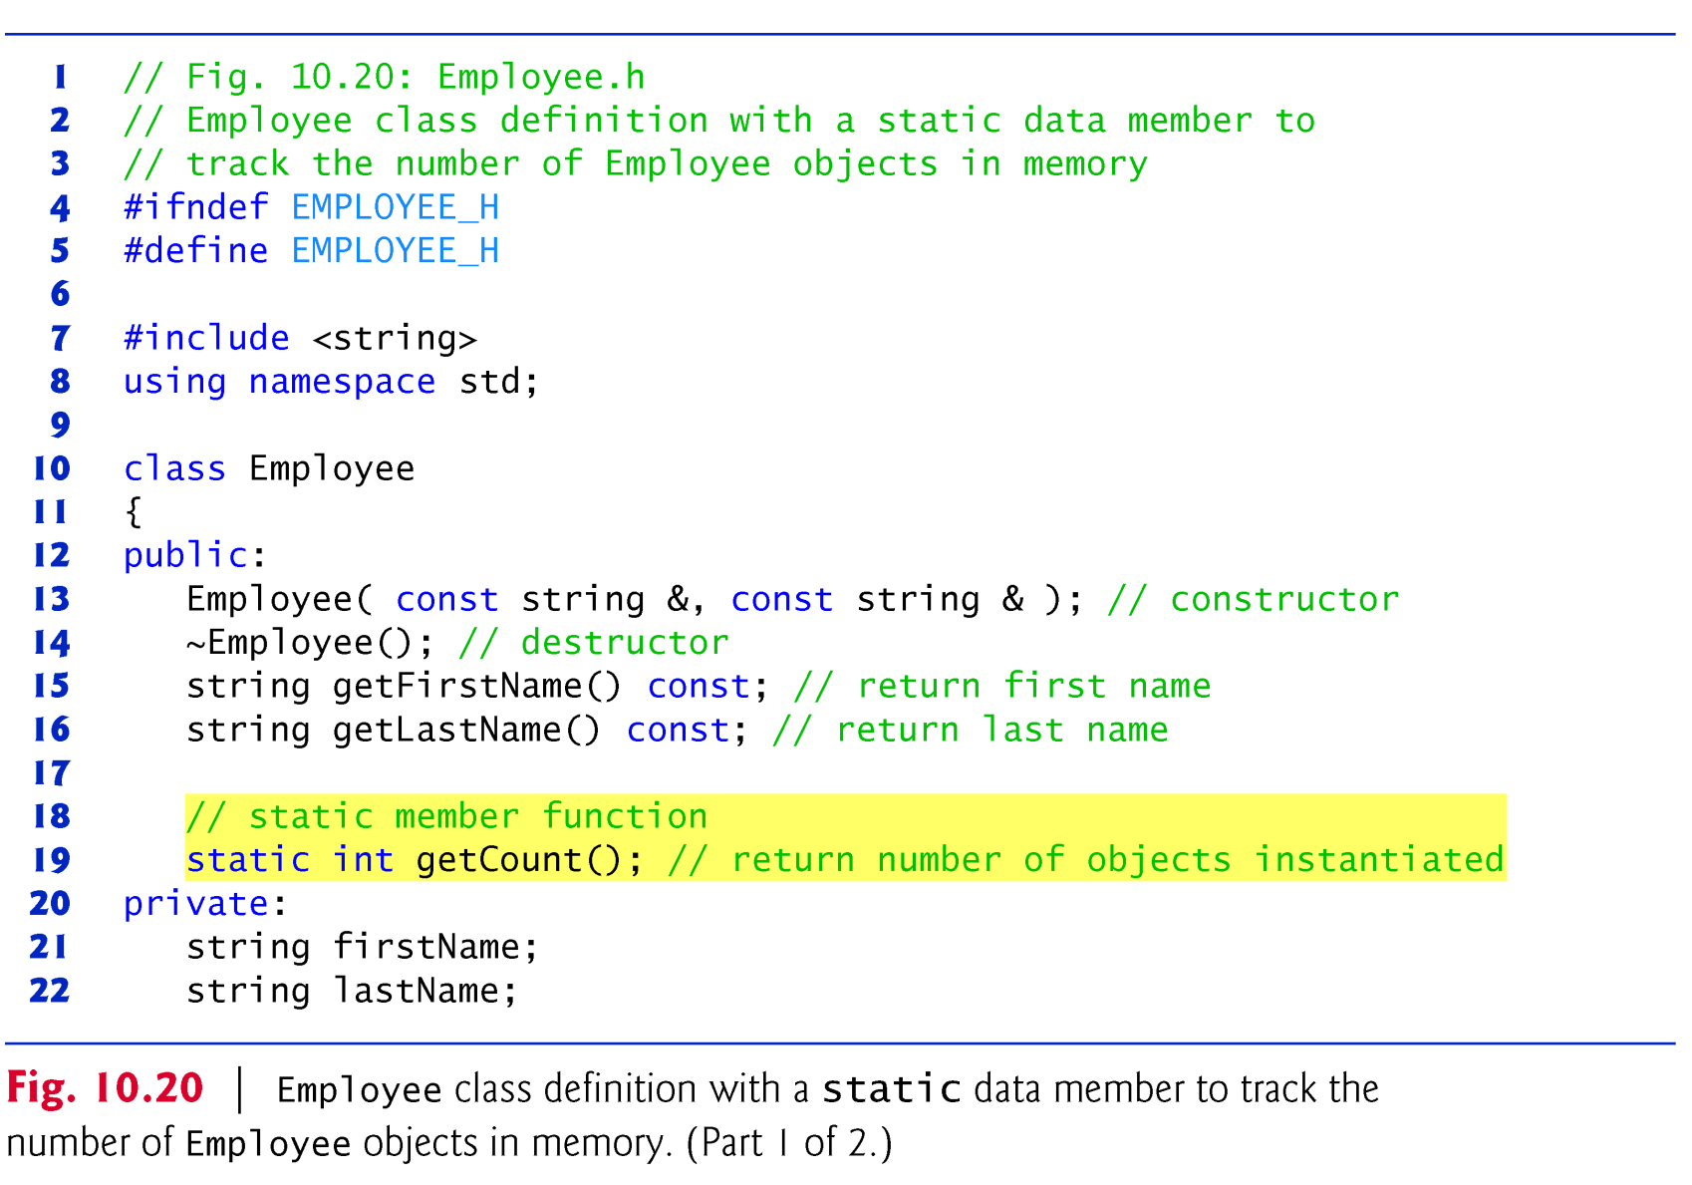

Slide 81
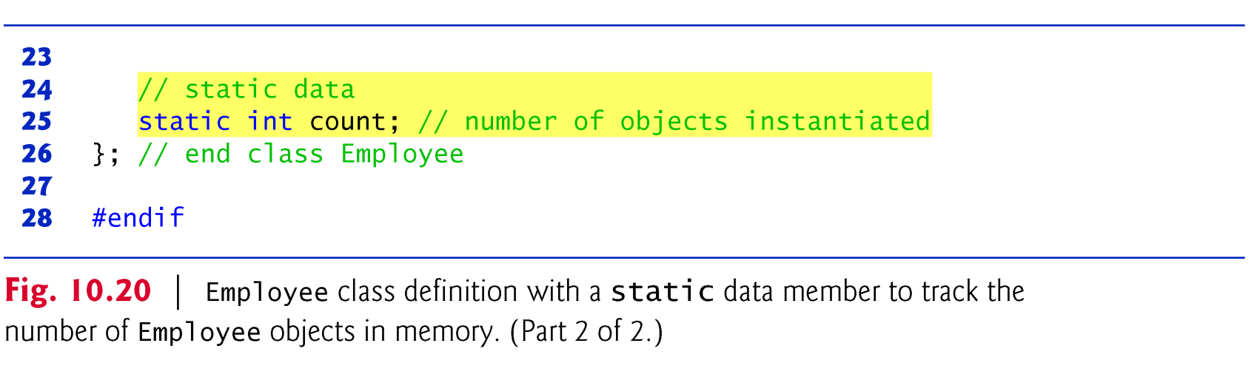

Slide 82
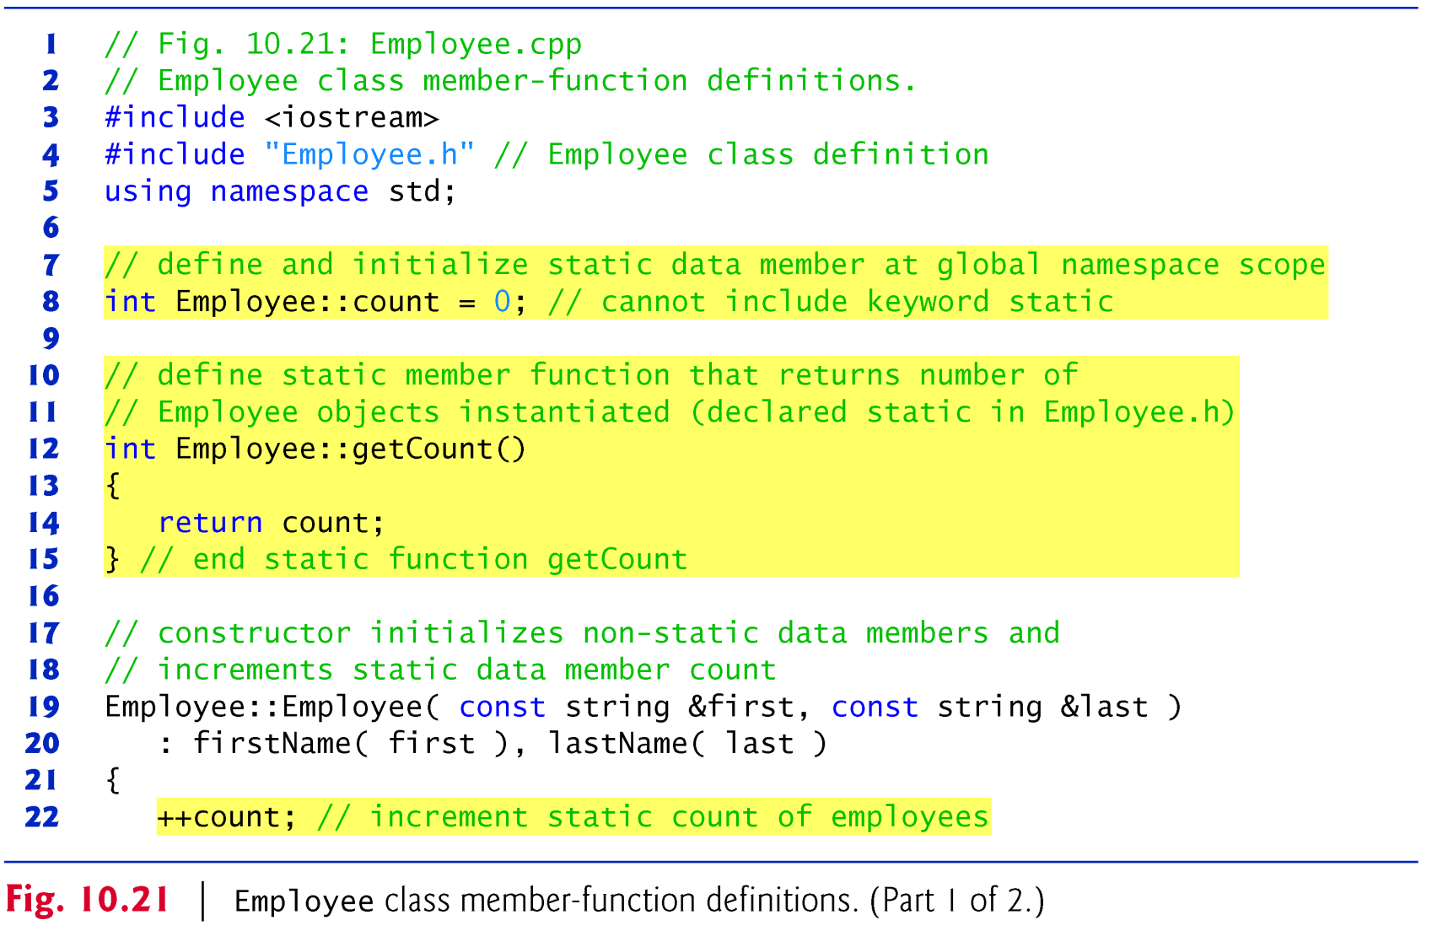

Slide 83
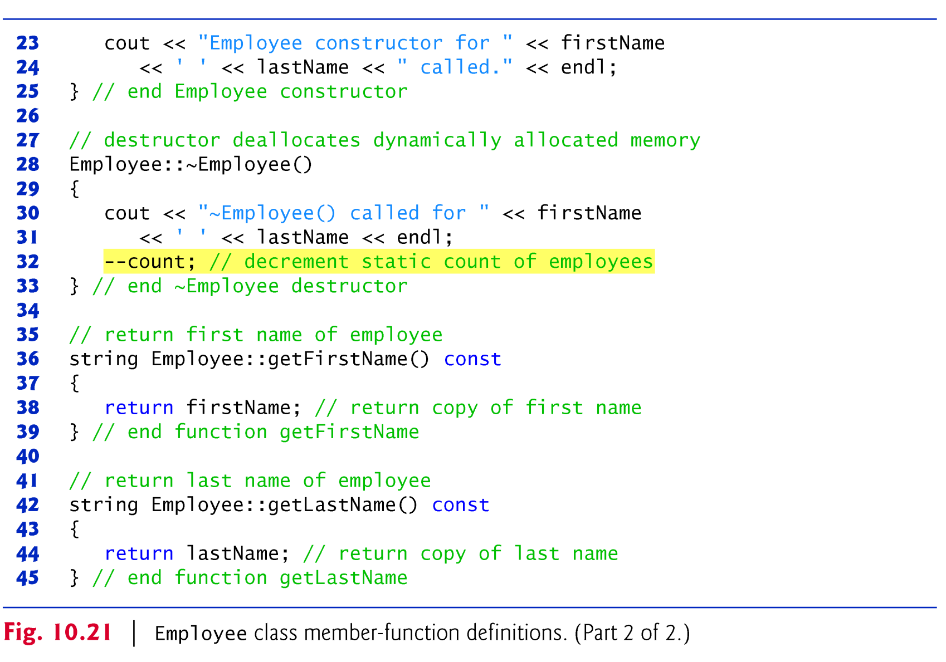

Slide 84
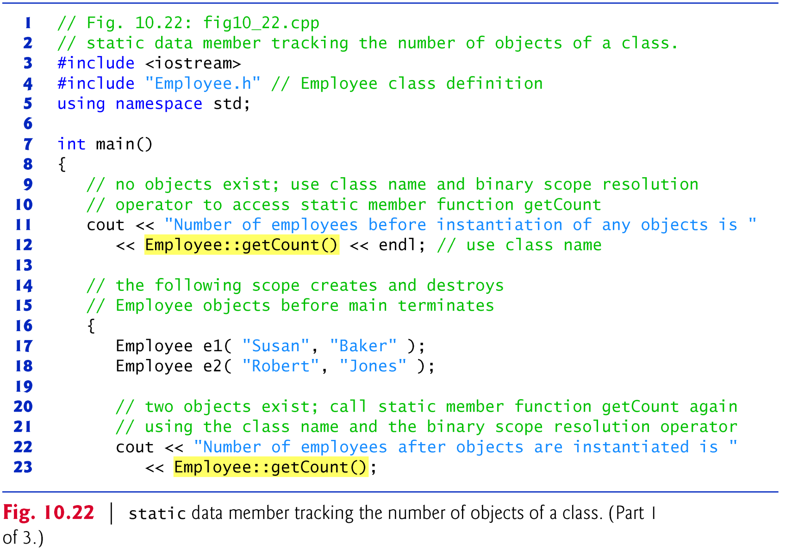

Slide 85
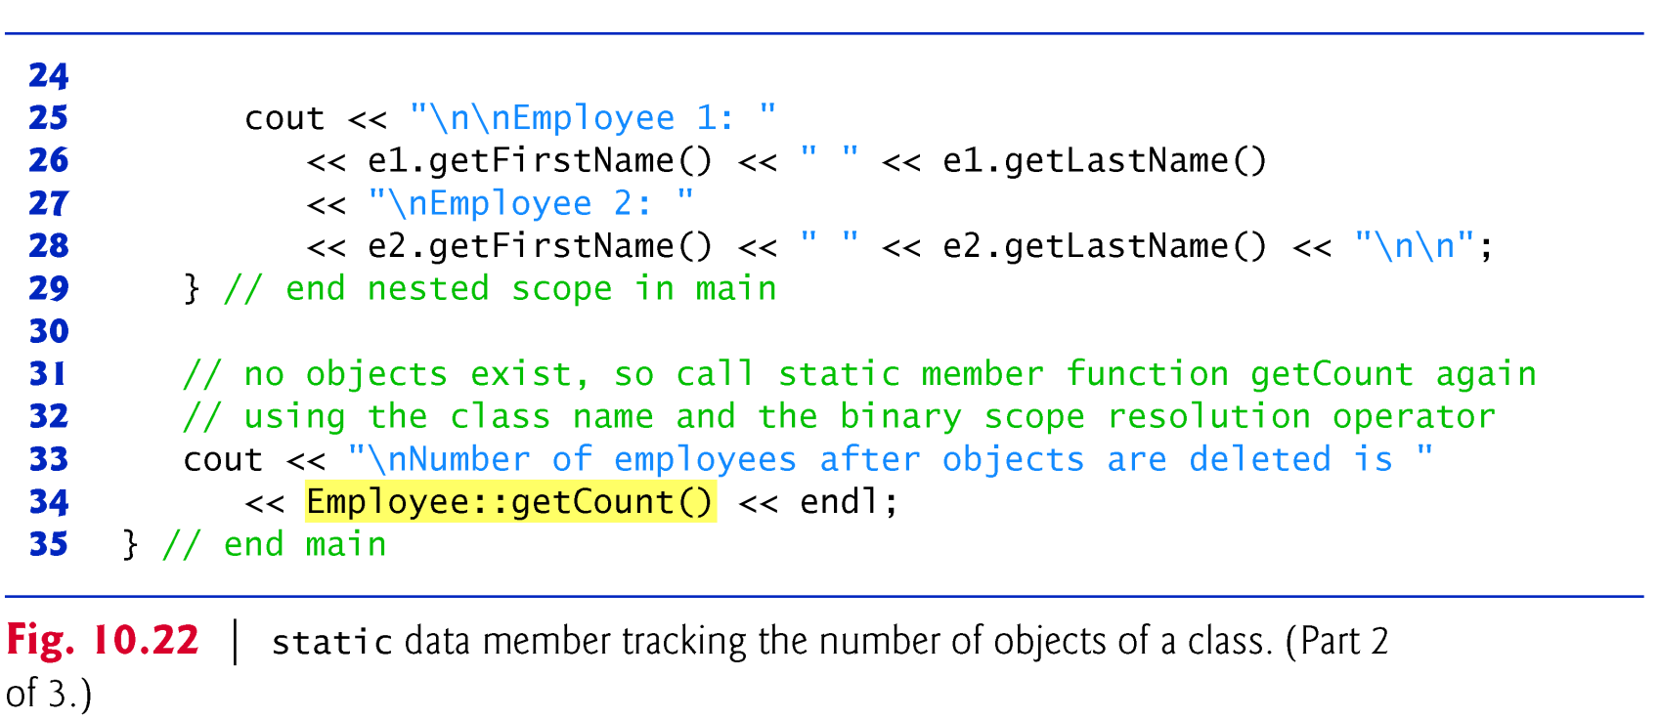

Slide 86
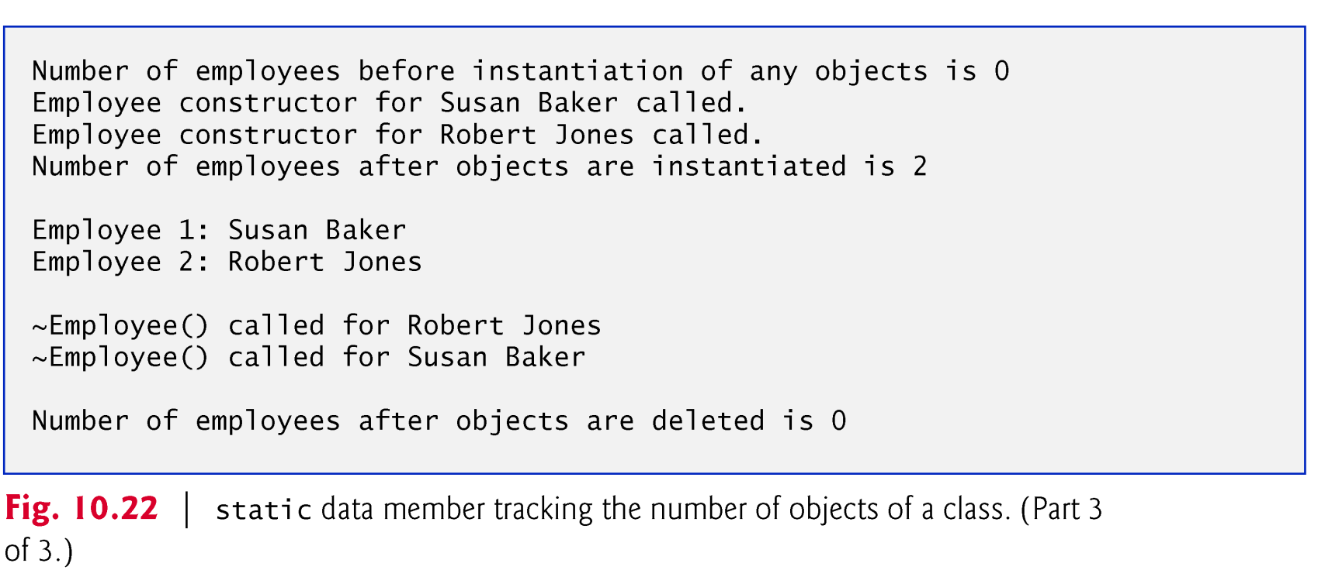

Slide 87
10.6 static Class Members (cont.)
A member function should be declared static if it does not access non-static data members or non-static member functions of the class.
A static member function does not have a this pointer, because static data members and static member functions exist independently of any objects of a class.
The this pointer must refer to a specific object of the class, and when a static member function is called, there might not be any objects of its class in memory.

Slide 88
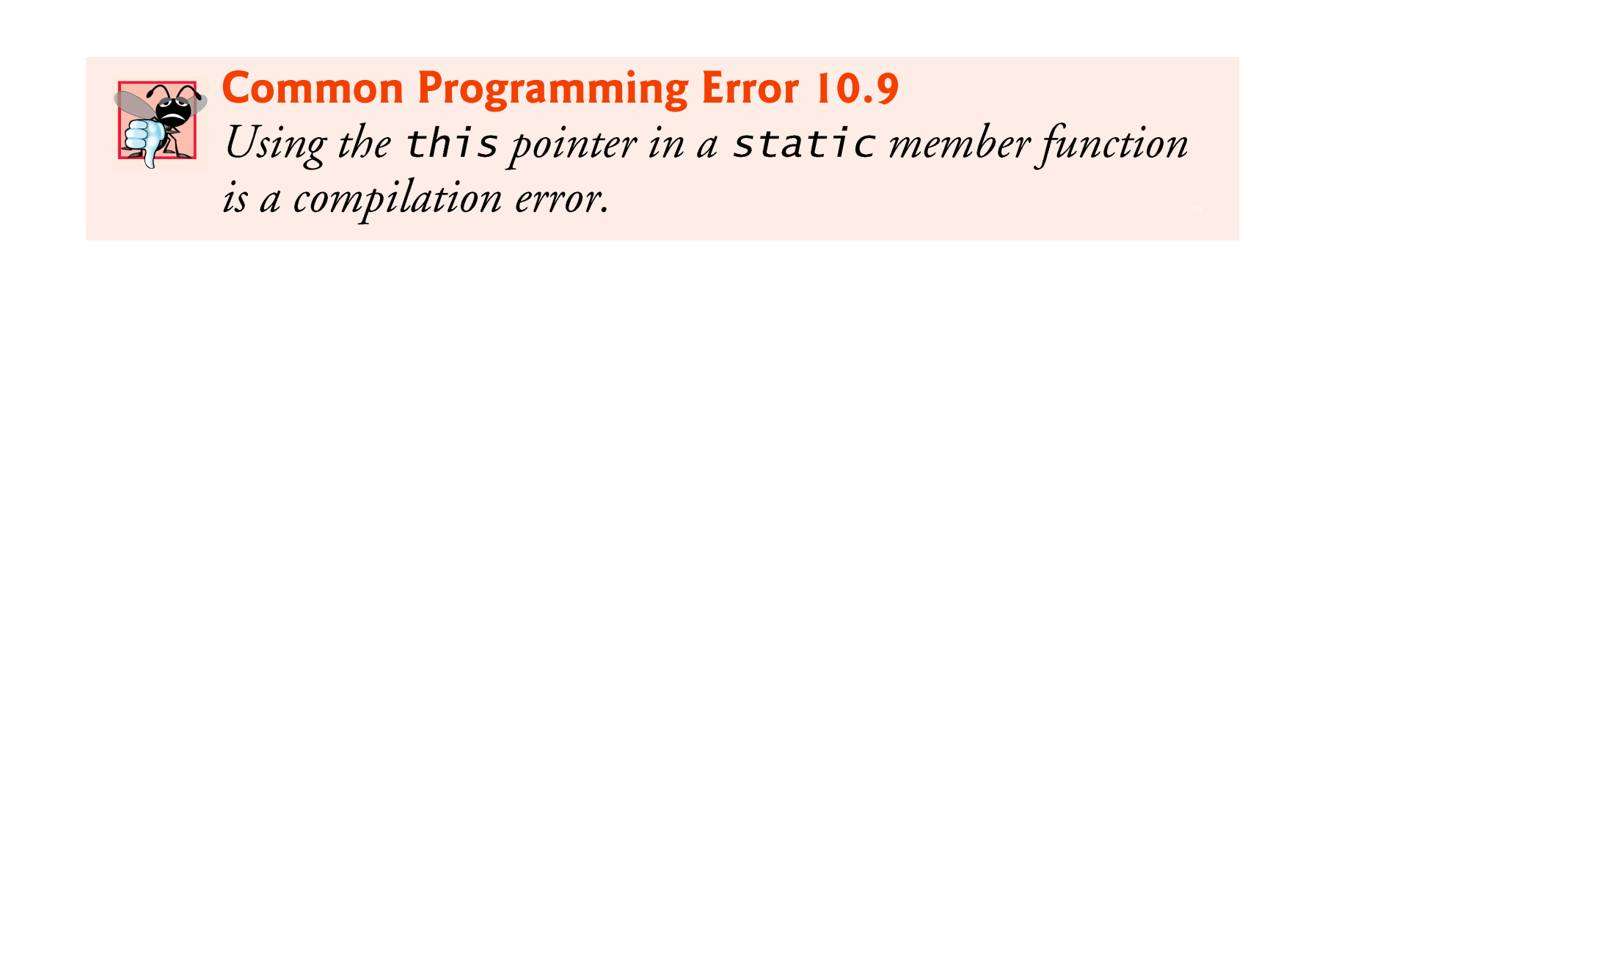

Slide 89
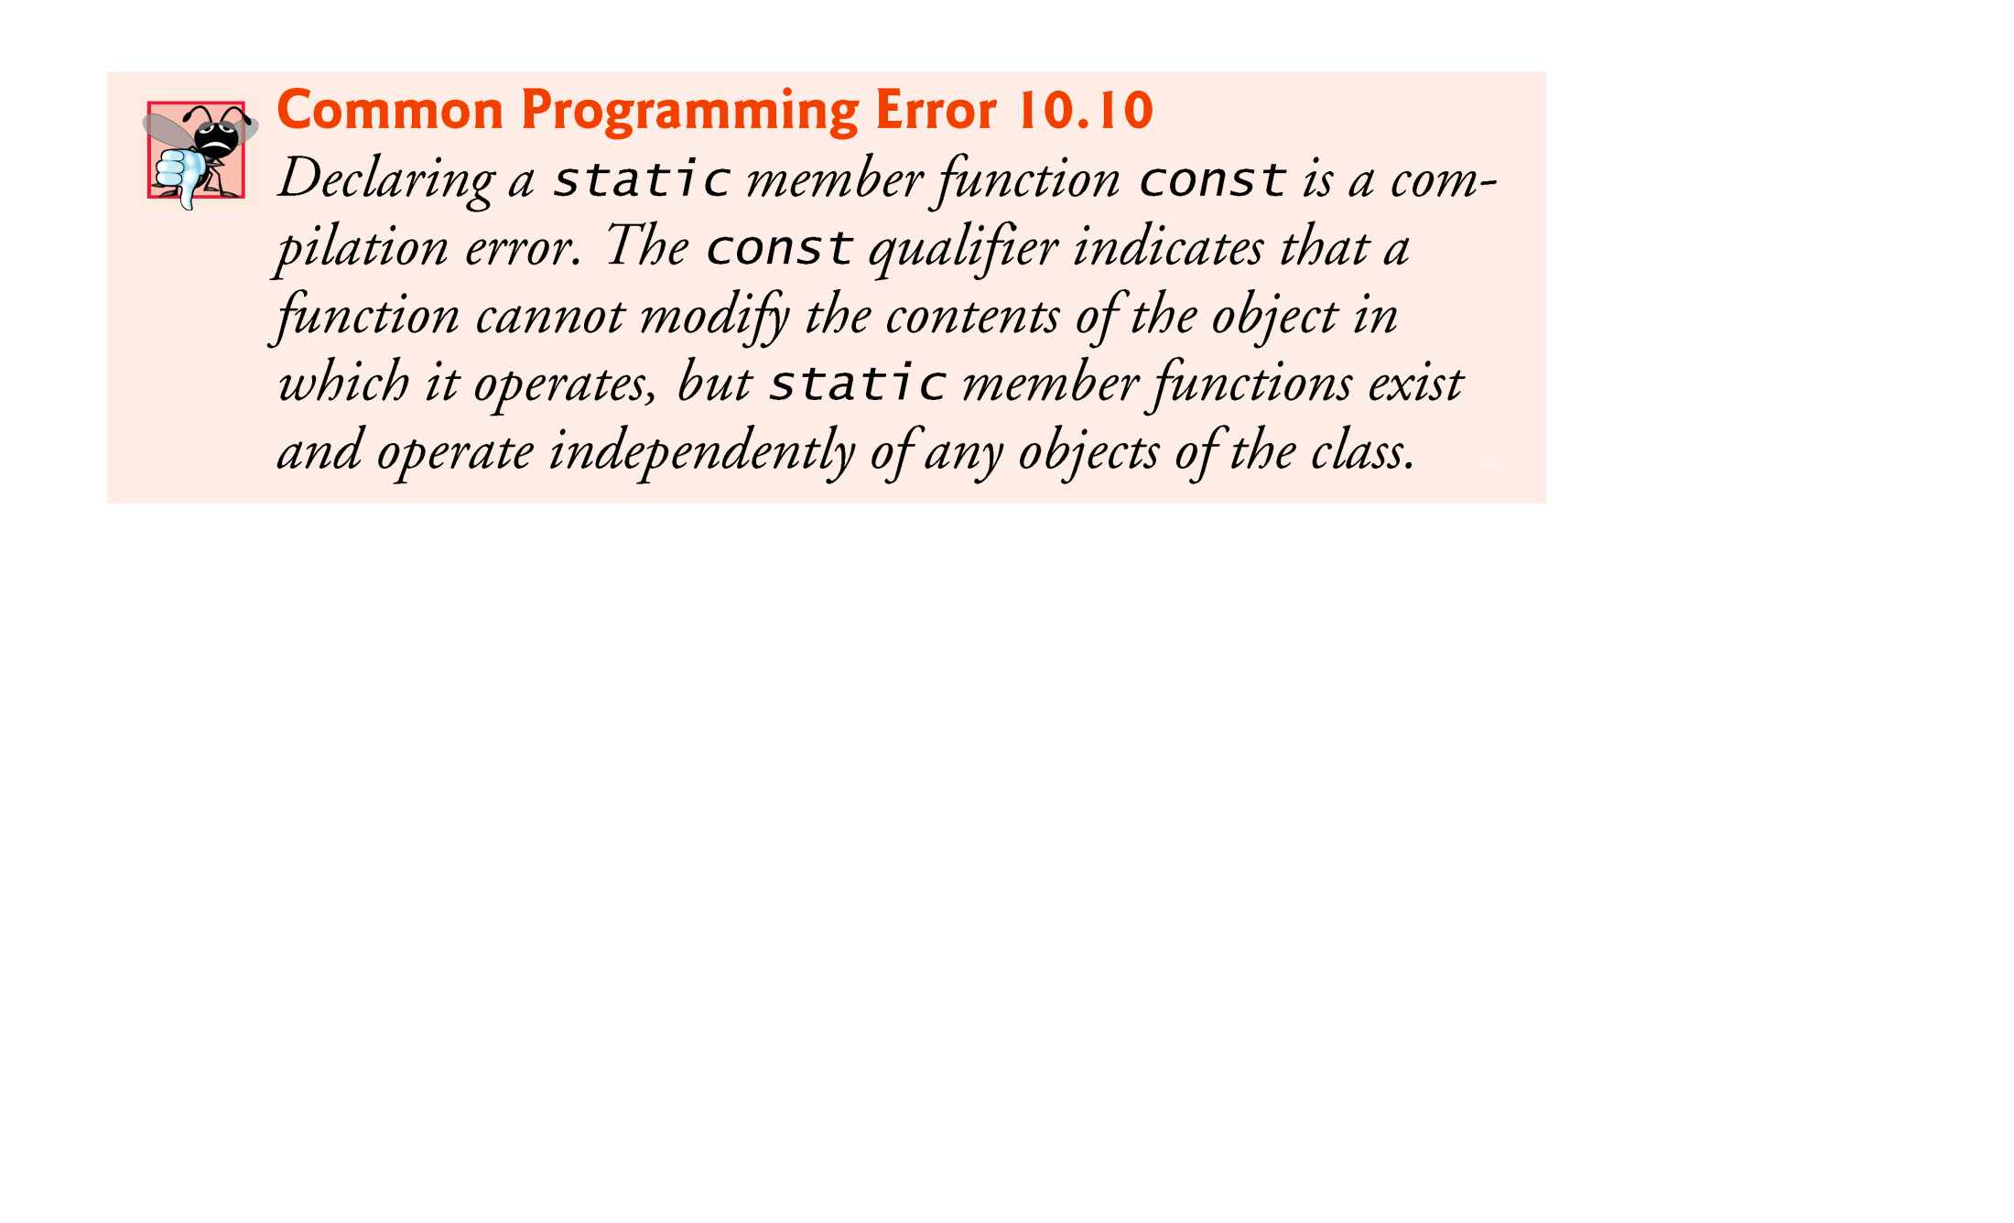

Slide 90
10.7 Data Abstraction and Information Hiding
Classes normally hide the details of their implementation from their clients.
This is called information hiding.
Consider the stack data structure.
Stacks can be implemented with arrays and with other data structures, such as linked lists.
The client knows only that when data items are placed in the stack, they will be recalled in last-in, first-out order.
The client cares about what functionality a stack offers, not about how that functionality is implemented.
This concept is referred to as data abstraction.

Slide 91
10.7 Data Abstraction and Information Hiding (cont.)
Although you might know the details of a class’s implementation, you should not write code that depends on these details as the details may later change.
This enables a particular class (such as one that implements a stack and its operations, push and pop) to be replaced with another version without affecting the rest of the system.
As long as the public services of the class do not change (i.e., every original public member function still has the same prototype in the new class definition), the rest of the system is not affected.

Slide 92
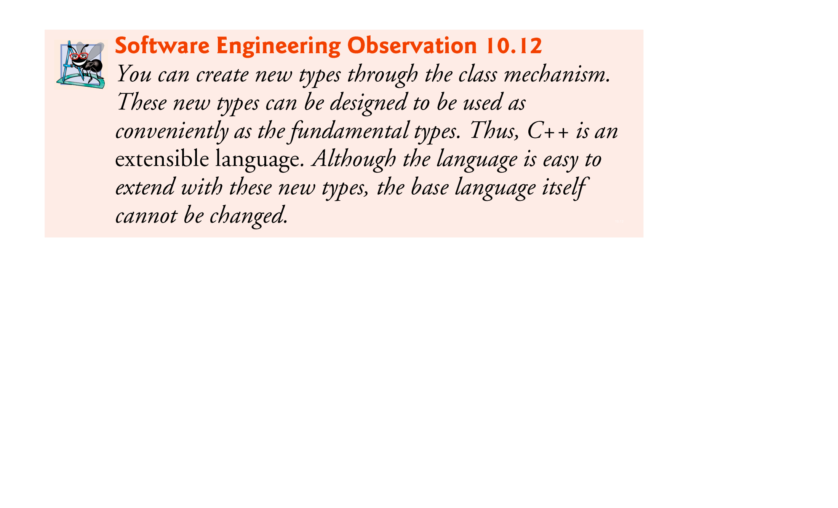

Slide 94
Time &Time::setHour( int h )
{
hour = ( h >= 0 && h < 24 ) ? h : 0;
return *this;
}
Time &Time::setMinute( int m )
{
minute = ( m >= 0 && m < 60 ) ? m : 0;
return *this;
}
Time &Time::setSecond( int s )
{
second = ( s >= 0 && s < 60 ) ? s : 0;
return *this;
}
int main()
{
Time t;
t.setHour( 8 ).setMinute( 5 ).setSecond( 2 );
}

Slide 95
Time &Time::setHour( int h, Test * const this )
{
hour = ( h >= 0 && h < 24 ) ? h : 0;
return *this;
}
Time &Time::setMinute( int m, Test * const this )
{
minute = ( m >= 0 && m < 60 ) ? m : 0;
return *this;
}
Time &Time::setSecond( int s, Test * const this )
{
second = ( s >= 0 && s < 60 ) ? s : 0;
return *this;
}
int main()
{
Time t;
t.setHour( 8, &t ).setMinute( 5, &an1 ).setSecond( 2, &an2 );
}

Slide 96
Time &Time::setHour( int h, Test * const this )
{
hour = ( h >= 0 && h < 24 ) ? h : 0;
return *this;
}
Time &Time::setMinute( int m, Test * const this )
{
minute = ( m >= 0 && m < 60 ) ? m : 0;
return *this;
}
Time &Time::setSecond( int s, Test * const this )
{
second = ( s >= 0 && s < 60 ) ? s : 0;
return *this;
}
int main()
{
Time t;
t.setHour( 8, &t ).setMinute( 5, &an1 ).setSecond( 2, &an2 );
}
t.hour | 0 | 0037FE60
t.minute | 0 | 0037FE64
t.second | 0 | 0037FE68

Slide 97
8 | 0037FD80
Time &Time::setHour( int h, Test * const this )
{
hour = ( h >= 0 && h < 24 ) ? h : 0;
return *this;
}
Time &Time::setMinute( int m, Test * const this )
{
minute = ( m >= 0 && m < 60 ) ? m : 0;
return *this;
}
Time &Time::setSecond( int s, Test * const this )
{
second = ( s >= 0 && s < 60 ) ? s : 0;
return *this;
}
int main()
{
Time t;
t.setHour( 8, &t ).setMinute( 5, &an1 ).setSecond( 2, &an2 );
}
0037FE60 | 00B2F7E8
t.hour | 0 | 0037FE60
t.minute | 0 | 0037FE64
t.second | 0 | 0037FE68

Slide 98
8 | 0037FD80
Time &Time::setHour( int h, Test * const this )
{
hour = ( h >= 0 && h < 24 ) ? h : 0;
return *this;
}
Time &Time::setMinute( int m, Test * const this )
{
minute = ( m >= 0 && m < 60 ) ? m : 0;
return *this;
}
Time &Time::setSecond( int s, Test * const this )
{
second = ( s >= 0 && s < 60 ) ? s : 0;
return *this;
}
int main()
{
Time t;
t.setHour( 8, &t ).setMinute( 5, &an1 ).setSecond( 2, &an2 );
}
0037FE60 | 00B2F7E8
t.hour | 8 | 0037FE60
t.minute | 0 | 0037FE64
t.second | 0 | 0037FE68

Slide 100
Time &Time::setHour( int h )
{
hour = ( h >= 0 && h < 24 ) ? h : 0;
return *this;
}
Time &Time::setMinute( int m )
{
minute = ( m >= 0 && m < 60 ) ? m : 0;
return *this;
}
Time &Time::setSecond( int s )
{
second = ( s >= 0 && s < 60 ) ? s : 0;
return *this;
}
int main()
{
Time t;
t.setHour( 18 ).setMinute( 30 ).setSecond( 22 );
}
this | 0000BBCC
t.hour | 0037FE60 | 0
t.minute | 0037FE64 | 0
t.second | 0037FE68 | 0

Slide 101
h | 0037FD80 | 18
Time &Time::setHour( int h )
{
hour = ( h >= 0 && h < 24 ) ? h : 0;
return *this;
}
Time &Time::setMinute( int m )
{
minute = ( m >= 0 && m < 60 ) ? m : 0;
return *this;
}
Time &Time::setSecond( int s )
{
second = ( s >= 0 && s < 60 ) ? s : 0;
return *this;
}
int main()
{
Time t;
t.setHour( 18 ).setMinute( 30 ).setSecond( 22 );
}
this | 0000BBCC
t.hour | 0037FE60 | 0
t.minute | 0037FE64 | 0
t.second | 0037FE68 | 0

Slide 102
h | 0037FD80 | 18
Time &Time::setHour( int h )
{
hour = ( h >= 0 && h < 24 ) ? h : 0;
return *this;
}
Time &Time::setMinute( int m )
{
minute = ( m >= 0 && m < 60 ) ? m : 0;
return *this;
}
Time &Time::setSecond( int s )
{
second = ( s >= 0 && s < 60 ) ? s : 0;
return *this;
}
int main()
{
Time t;
t.setHour( 18 ).setMinute( 30 ).setSecond( 22 );
}
this | 0000BBCC | 0037FE60
t.hour | 0037FE60 | 0
t.minute | 0037FE64 | 0
t.second | 0037FE68 | 0

Slide 103
h | 0037FD80 | 18
Time &Time::setHour( int h )
{
hour = ( h >= 0 && h < 24 ) ? h : 0;
return *this;
}
Time &Time::setMinute( int m )
{
minute = ( m >= 0 && m < 60 ) ? m : 0;
return *this;
}
Time &Time::setSecond( int s )
{
second = ( s >= 0 && s < 60 ) ? s : 0;
return *this;
}
int main()
{
Time t;
t.setHour( 18 ).setMinute( 30 ).setSecond( 22 );
}
this | 0000BBCC | 0037FE60
t.hour | 0037FE60 | 18
t.minute | 0037FE64 | 0
t.second | 0037FE68 | 0

Slide 104
Time &Time::setHour( int h )
{
hour = ( h >= 0 && h < 24 ) ? h : 0;
return *this;
}
Time &Time::setMinute( int m )
{
minute = ( m >= 0 && m < 60 ) ? m : 0;
return *this;
}
Time &Time::setSecond( int s )
{
second = ( s >= 0 && s < 60 ) ? s : 0;
return *this;
}
int main()
{
Time t;
t.setHour( 18 ).setMinute( 30 ).setSecond( 22 );
}
this | 0000BBCC | 0037FE60
t.hour | 0037FE60 | 18
t.minute | 0037FE64 | 0
t.second | 0037FE68 | 0

Slide 105
m | 0037FD80 | 30
Time &Time::setHour( int h )
{
hour = ( h >= 0 && h < 24 ) ? h : 0;
return *this;
}
Time &Time::setMinute( int m )
{
minute = ( m >= 0 && m < 60 ) ? m : 0;
return *this;
}
Time &Time::setSecond( int s )
{
second = ( s >= 0 && s < 60 ) ? s : 0;
return *this;
}
int main()
{
Time t;
t.setHour( 18 ).setMinute( 30 ).setSecond( 22 );
}
this | 0000BBCC | 0037FE60
t.hour | 0037FE60 | 18
t.minute | 0037FE64 | 0
t.second | 0037FE68 | 0

Slide 106
m | 0037FD80 | 30
Time &Time::setHour( int h )
{
hour = ( h >= 0 && h < 24 ) ? h : 0;
return *this;
}
Time &Time::setMinute( int m )
{
minute = ( m >= 0 && m < 60 ) ? m : 0;
return *this;
}
Time &Time::setSecond( int s )
{
second = ( s >= 0 && s < 60 ) ? s : 0;
return *this;
}
int main()
{
Time t;
t.setHour( 18 ).setMinute( 30 ).setSecond( 22 );
}
this | 0000BBCC | 0037FE60
t.hour | 0037FE60 | 18
t.minute | 0037FE64 | 30
t.second | 0037FE68 | 0

Slide 107
Time &Time::setHour( int h )
{
hour = ( h >= 0 && h < 24 ) ? h : 0;
return *this;
}
Time &Time::setMinute( int m )
{
minute = ( m >= 0 && m < 60 ) ? m : 0;
return *this;
}
Time &Time::setSecond( int s )
{
second = ( s >= 0 && s < 60 ) ? s : 0;
return *this;
}
int main()
{
Time t;
t.setHour( 18 ).setMinute( 30 ).setSecond( 22 );
}
this | 0000BBCC | 0037FE60
t.hour | 0037FE60 | 18
t.minute | 0037FE64 | 30
t.second | 0037FE68 | 0

Slide 108
s | 0037FD80 | 22
Time &Time::setHour( int h )
{
hour = ( h >= 0 && h < 24 ) ? h : 0;
return *this;
}
Time &Time::setMinute( int m )
{
minute = ( m >= 0 && m < 60 ) ? m : 0;
return *this;
}
Time &Time::setSecond( int s )
{
second = ( s >= 0 && s < 60 ) ? s : 0;
return *this;
}
int main()
{
Time t;
t.setHour( 18 ).setMinute( 30 ).setSecond( 22 );
}
this | 0000BBCC | 0037FE60
t.hour | 0037FE60 | 18
t.minute | 0037FE64 | 30
t.second | 0037FE68 | 0

Slide 109
s | 0037FD80 | 22
Time &Time::setHour( int h )
{
hour = ( h >= 0 && h < 24 ) ? h : 0;
return *this;
}
Time &Time::setMinute( int m )
{
minute = ( m >= 0 && m < 60 ) ? m : 0;
return *this;
}
Time &Time::setSecond( int s )
{
second = ( s >= 0 && s < 60 ) ? s : 0;
return *this;
}
int main()
{
Time t;
t.setHour( 18 ).setMinute( 30 ).setSecond( 22 );
}
this | 0000BBCC | 0037FE60
t.hour | 0037FE60 | 18
t.minute | 0037FE64 | 30
t.second | 0037FE68 | 22

Slide 110
Time &Time::setHour( int h )
{
hour = ( h >= 0 && h < 24 ) ? h : 0;
return *this;
}
Time &Time::setMinute( int m )
{
minute = ( m >= 0 && m < 60 ) ? m : 0;
return *this;
}
Time &Time::setSecond( int s )
{
second = ( s >= 0 && s < 60 ) ? s : 0;
return *this;
}
int main()
{
Time t;
t.setHour( 18 ).setMinute( 30 ).setSecond( 22 );
}
this | 0000BBCC | 0037FE60
t.hour | 0037FE60 | 18
t.minute | 0037FE64 | 30
t.second | 0037FE68 | 22

Slide 112
Time Time::setHour( int h )
{
hour = ( h >= 0 && h < 24 ) ? h : 0;
return *this;
}
Time Time::setMinute( int m )
{
minute = ( m >= 0 && m < 60 ) ? m : 0;
return *this;
}
Time Time::setSecond( int s )
{
second = ( s >= 0 && s < 60 ) ? s : 0;
return *this;
}
int main()
{
Time t;
t.setHour( 18 ).setMinute( 30 ).setSecond( 22 );
}
this | 0000BBCC
t.hour | 0037FE60 | 0
t.minute | 0037FE64 | 0
t.second | 0037FE68 | 0

Slide 113
h | 0037FD80 | 18
Time Time::setHour( int h )
{
hour = ( h >= 0 && h < 24 ) ? h : 0;
return *this;
}
Time Time::setMinute( int m )
{
minute = ( m >= 0 && m < 60 ) ? m : 0;
return *this;
}
Time Time::setSecond( int s )
{
second = ( s >= 0 && s < 60 ) ? s : 0;
return *this;
}
int main()
{
Time t;
t.setHour( 18 ).setMinute( 30 ).setSecond( 22 );
}
this | 0000BBCC
t.hour | 0037FE60 | 0
t.minute | 0037FE64 | 0
t.second | 0037FE68 | 0

Slide 114
h | 0037FD80 | 18
Time Time::setHour( int h )
{
hour = ( h >= 0 && h < 24 ) ? h : 0;
return *this;
}
Time Time::setMinute( int m )
{
minute = ( m >= 0 && m < 60 ) ? m : 0;
return *this;
}
Time Time::setSecond( int s )
{
second = ( s >= 0 && s < 60 ) ? s : 0;
return *this;
}
int main()
{
Time t;
t.setHour( 18 ).setMinute( 30 ).setSecond( 22 );
}
this | 0000BBCC | 0037FE60
t.hour | 0037FE60 | 0
t.minute | 0037FE64 | 0
t.second | 0037FE68 | 0

Slide 115
h | 0037FD80 | 18
Time Time::setHour( int h )
{
hour = ( h >= 0 && h < 24 ) ? h : 0;
return *this;
}
Time Time::setMinute( int m )
{
minute = ( m >= 0 && m < 60 ) ? m : 0;
return *this;
}
Time Time::setSecond( int s )
{
second = ( s >= 0 && s < 60 ) ? s : 0;
return *this;
}
int main()
{
Time t;
t.setHour( 18 ).setMinute( 30 ).setSecond( 22 );
}
this | 0000BBCC | 0037FE60
t.hour | 0037FE60 | 18
t.minute | 0037FE64 | 0
t.second | 0037FE68 | 0

Slide 116
Time Time::setHour( int h )
{
hour = ( h >= 0 && h < 24 ) ? h : 0;
return *this;
}
Time Time::setMinute( int m )
{
minute = ( m >= 0 && m < 60 ) ? m : 0;
return *this;
}
Time Time::setSecond( int s )
{
second = ( s >= 0 && s < 60 ) ? s : 0;
return *this;
}
int main()
{
Time t;
t.setHour( 18 ).setMinute( 30 ).setSecond( 22 );
}
this | 0000BBCC | 0037FE60
hour | 0037FE50 | 18
minute | 0037FE54 | 0
second | 0037FE58 | 0
t.hour | 0037FE60 | 18
t.minute | 0037FE64 | 0
t.second | 0037FE68 | 0

Slide 117
m | 0037FD84 | 30
Time Time::setHour( int h )
{
hour = ( h >= 0 && h < 24 ) ? h : 0;
return *this;
}
Time Time::setMinute( int m )
{
minute = ( m >= 0 && m < 60 ) ? m : 0;
return *this;
}
Time Time::setSecond( int s )
{
second = ( s >= 0 && s < 60 ) ? s : 0;
return *this;
}
int main()
{
Time t;
t.setHour( 18 ).setMinute( 30 ).setSecond( 22 );
}
this | 0000BBCC | 0037FE60
hour | 0037FE50 | 18
minute | 0037FE54 | 0
second | 0037FE58 | 0
t.hour | 0037FE60 | 18
t.minute | 0037FE64 | 0
t.second | 0037FE68 | 0

Slide 118
m | 0037FD84 | 30
Time Time::setHour( int h )
{
hour = ( h >= 0 && h < 24 ) ? h : 0;
return *this;
}
Time Time::setMinute( int m )
{
minute = ( m >= 0 && m < 60 ) ? m : 0;
return *this;
}
Time Time::setSecond( int s )
{
second = ( s >= 0 && s < 60 ) ? s : 0;
return *this;
}
int main()
{
Time t;
t.setHour( 18 ).setMinute( 30 ).setSecond( 22 );
}
this | 0000BBCC | 0037FE50
hour | 0037FE50 | 18
minute | 0037FE54 | 0
second | 0037FE58 | 0
t.hour | 0037FE60 | 18
t.minute | 0037FE64 | 0
t.second | 0037FE68 | 0

Slide 119
m | 0037FD84 | 30
Time Time::setHour( int h )
{
hour = ( h >= 0 && h < 24 ) ? h : 0;
return *this;
}
Time Time::setMinute( int m )
{
minute = ( m >= 0 && m < 60 ) ? m : 0;
return *this;
}
Time Time::setSecond( int s )
{
second = ( s >= 0 && s < 60 ) ? s : 0;
return *this;
}
int main()
{
Time t;
t.setHour( 18 ).setMinute( 30 ).setSecond( 22 );
}
this | 0000BBCC | 0037FE50
hour | 0037FE50 | 18
minute | 0037FE54 | 30
second | 0037FE58 | 0
t.hour | 0037FE60 | 18
t.minute | 0037FE64 | 0
t.second | 0037FE68 | 0

Slide 120
Time Time::setHour( int h )
{
hour = ( h >= 0 && h < 24 ) ? h : 0;
return *this;
}
Time Time::setMinute( int m )
{
minute = ( m >= 0 && m < 60 ) ? m : 0;
return *this;
}
Time Time::setSecond( int s )
{
second = ( s >= 0 && s < 60 ) ? s : 0;
return *this;
}
int main()
{
Time t;
t.setHour( 18 ).setMinute( 30 ).setSecond( 22 );
}
hour | 0037FE40 | 18
minute | 0037FE44 | 30
second | 0037FE48 | 0
this | 0000BBCC | 0037FE50
hour | 0037FE50 | 18
minute | 0037FE54 | 30
second | 0037FE58 | 0
t.hour | 0037FE60 | 18
t.minute | 0037FE64 | 0
t.second | 0037FE68 | 0

Slide 121
s | 0037FD84 | 22
Time Time::setHour( int h )
{
hour = ( h >= 0 && h < 24 ) ? h : 0;
return *this;
}
Time Time::setMinute( int m )
{
minute = ( m >= 0 && m < 60 ) ? m : 0;
return *this;
}
Time Time::setSecond( int s )
{
second = ( s >= 0 && s < 60 ) ? s : 0;
return *this;
}
int main()
{
Time t;
t.setHour( 18 ).setMinute( 30 ).setSecond( 22 );
}
hour | 0037FE40 | 18
minute | 0037FE44 | 30
second | 0037FE48 | 0
this | 0000BBCC | 0037FE50
hour | 0037FE50 | 18
minute | 0037FE54 | 30
second | 0037FE58 | 0
t.hour | 0037FE60 | 18
t.minute | 0037FE64 | 0
t.second | 0037FE68 | 0

Slide 122
s | 0037FD84 | 22
Time Time::setHour( int h )
{
hour = ( h >= 0 && h < 24 ) ? h : 0;
return *this;
}
Time Time::setMinute( int m )
{
minute = ( m >= 0 && m < 60 ) ? m : 0;
return *this;
}
Time Time::setSecond( int s )
{
second = ( s >= 0 && s < 60 ) ? s : 0;
return *this;
}
int main()
{
Time t;
t.setHour( 18 ).setMinute( 30 ).setSecond( 22 );
}
hour | 0037FE40 | 18
minute | 0037FE44 | 30
second | 0037FE48 | 0
this | 0000BBCC | 0037FE40
hour | 0037FE50 | 18
minute | 0037FE54 | 30
second | 0037FE58 | 0
t.hour | 0037FE60 | 18
t.minute | 0037FE64 | 0
t.second | 0037FE68 | 0

Slide 124
Engine::Engine( const Engine &engine )
: modelNumber( engine.modelNumber )
{
}
Car::Car( const string m, const Engine &e )
: model( m ),
engine( e ) engine.Engine( e )
{
}
int main()
{
Engine benzM264Engine( "M264" );
benzM264Engine.Engine( "M264" )
Car benzC200( "Benz C200", benzM264Engine );
benzC200.Car( "Benz C200", benzM264Engine )
benzC200.display();
}
benzC200.model
benzC200.engine
engine
e
benzM264Engine
M264
M264

Slide 125
Engine::Engine( const Engine &engine )
: modelNumber( engine.modelNumber )
{
}
Car::Car( const string m, const Engine &e )
: model( m ),
engine( e ) engine.Engine( e )
{
}
int main()
{
Engine benzM264Engine( "M264" );
benzM264Engine.Engine( "M264" )
Car benzC200( "Benz C200", benzM264Engine );
benzC200.Car( "Benz C200", benzM264Engine )
benzC200.display();
}
benzC200.model
benzC200.engine.modelNumber
engine
e
benzM264Engine.modelNumber
M264
M264

Slide 126
benzC200.model
benzC200.engine
Engine::Engine( const Engine &engine )
: modelNumber( engine.modelNumber )
{
}
Car::Car( const string m, const Engine &e )
: model( m ),
engine( e ) engine.Engine( e )
{
}
int main()
{
Engine benzM264Engine( "M264" );
benzM264Engine.Engine( "M264" )
Car benzC200( "Benz C200", benzM264Engine );
benzC200.Car( "Benz C200", benzM264Engine )
benzC200.display();
}
M264
modelNumber
engine
e
benzM264Engine
M264
M264
modelNumber

Slide 127
Engine::Engine( const Engine &engine )
: modelNumber( engine.modelNumber )
{
}
Car::Car( const string m, const Engine &e )
: model( m ),
engine( e ) engine.Engine( e )
{
}
int main()
{
Engine benzM264Engine( "M264" );
benzM264Engine.Engine( "M264" )
Car benzC200( "Benz C200", benzM264Engine );
benzC200.Car( "Benz C200", benzM264Engine )
benzC200.display();
}
engine
e
benzM264Engine
M264
M264
benzC200.model
benzC200.engine

Slide 128
Engine::Engine( const Engine &engine )
: modelNumber( engine.modelNumber )
{
}
Car::Car( const string m, const Engine &e )
: model( m ),
engine( e ) engine.Engine( e )
{
}
int main()
{
Engine benzM264Engine( "M264" );
benzM264Engine.Engine( "M264" )
Car benzC200( "Benz C200", benzM264Engine );
benzC200.Car( "Benz C200", benzM264Engine )
benzC200.display();
}
engine
e
benzM264Engine
M264
M264
benzC200.engine

